Slide 1
The Hidden Backbone of Indian Railways
A Graph Visualization and Network Analysis
Presented by
Divyanshu Agwekar (2430010132)
Puru Bansal (2430010153)
Graph Visualization (DSE3151) | Manipal University Jaipur
Notes:
Introduce yourselves and the project in one sentence: we treated the railway system as a graph of stations and links to find which stations and patterns matter most. (About 15 seconds.)

Slide 2
The question and the data
Research question
Which stations and structural patterns matter most for the connectivity of this Indian Railways network?
289
400
1
stations (nodes)
direct route links (edges)
connected component
Edge weight = the Weight column in our edge file (1 to 231); read as how often a link appears in train routes.
A table lists stations one by one. A graph shows how they connect: clusters, hubs, and links that hold groups together.
Raw data
8,990 stations
5,208 trains
Cleaned in
Python / Colab
Node + edge
CSV files
Gephi 0.11.3
layout + metrics
›
›
›
Notes:
Say: our question is which stations and patterns matter most for connectivity. A table can rank stations but cannot show how they connect. Data: about 8,990 station and 5,208 train records from the Indian Railway Data repository, cleaned in Python on Colab, exported as node and edge CSVs, then analysed in Gephi. The final graph has 289 stations, 400 links, and is one connected component. Edge weight comes from the Weight column; we read it as how many train routes share a link, but state that as our interpretation.

Slide 3
Layout: ForceAtlas 2
Criterion 1
Force-directed: every station repels, every link pulls its two ends together.
Tightly linked groups settle into clusters
Well-connected hubs move to the middle
Bridge stations end up between clusters
Needs only link data, no coordinates
Alternative | Why it fits less well
Circular | Treats all stations alike; hides clusters and hubs
Hierarchical | Needs a root and direction; our graph is undirected with loops
Geographic | Our data has no coordinates; geography would hide link structure
Settings in our Gephi project
30.0
Scaling
1.0
Gravity
1.0
Edge weight influence
off
LinLog / Prevent overlap
Notes:
Say: we used ForceAtlas 2, a force-directed layout. Think of stations as magnets that repel each other and links as springs that pull connected stations together. After it settles, groups that are densely linked end up side by side, hubs sit in the middle and bridge stations sit between groups. The settings are from our Gephi project file: scaling 2, gravity 1, edge weight influence 1, LinLog off, overlap prevention off. A circular layout would treat all stations equally, a hierarchy needs a root and direction, and a geographic map needs coordinates we do not have.

Slide 4
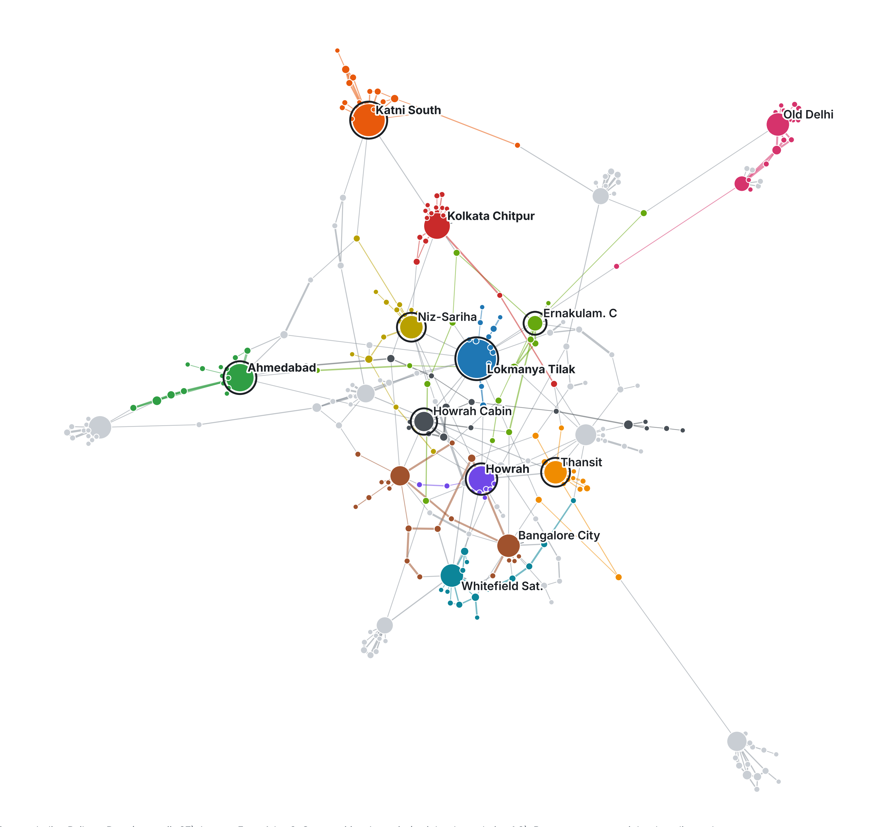
The network at a glance
Graph 1
Hubs
Largest dots: Lokmanya Tilak (24 links), Katni South (20), Ahmedabad (17)
Clusters
27 communities; each colour is one group of tightly linked stations
Bridges
Dark rings mark the 8 stations on the shortest paths
ForceAtlas 2 layout; Louvain communities (12 largest coloured).
Notes:
Walk the audience through three things. First, the big dots are hubs: Lokmanya Tilak has the most direct links. Second, colours are communities, groups of stations linked more tightly to each other than to the rest. Third, dark rings mark bridge stations, the ones that sit on the most shortest routes between other stations. If you want to show the live Gephi view, switch to it here.

Slide 5
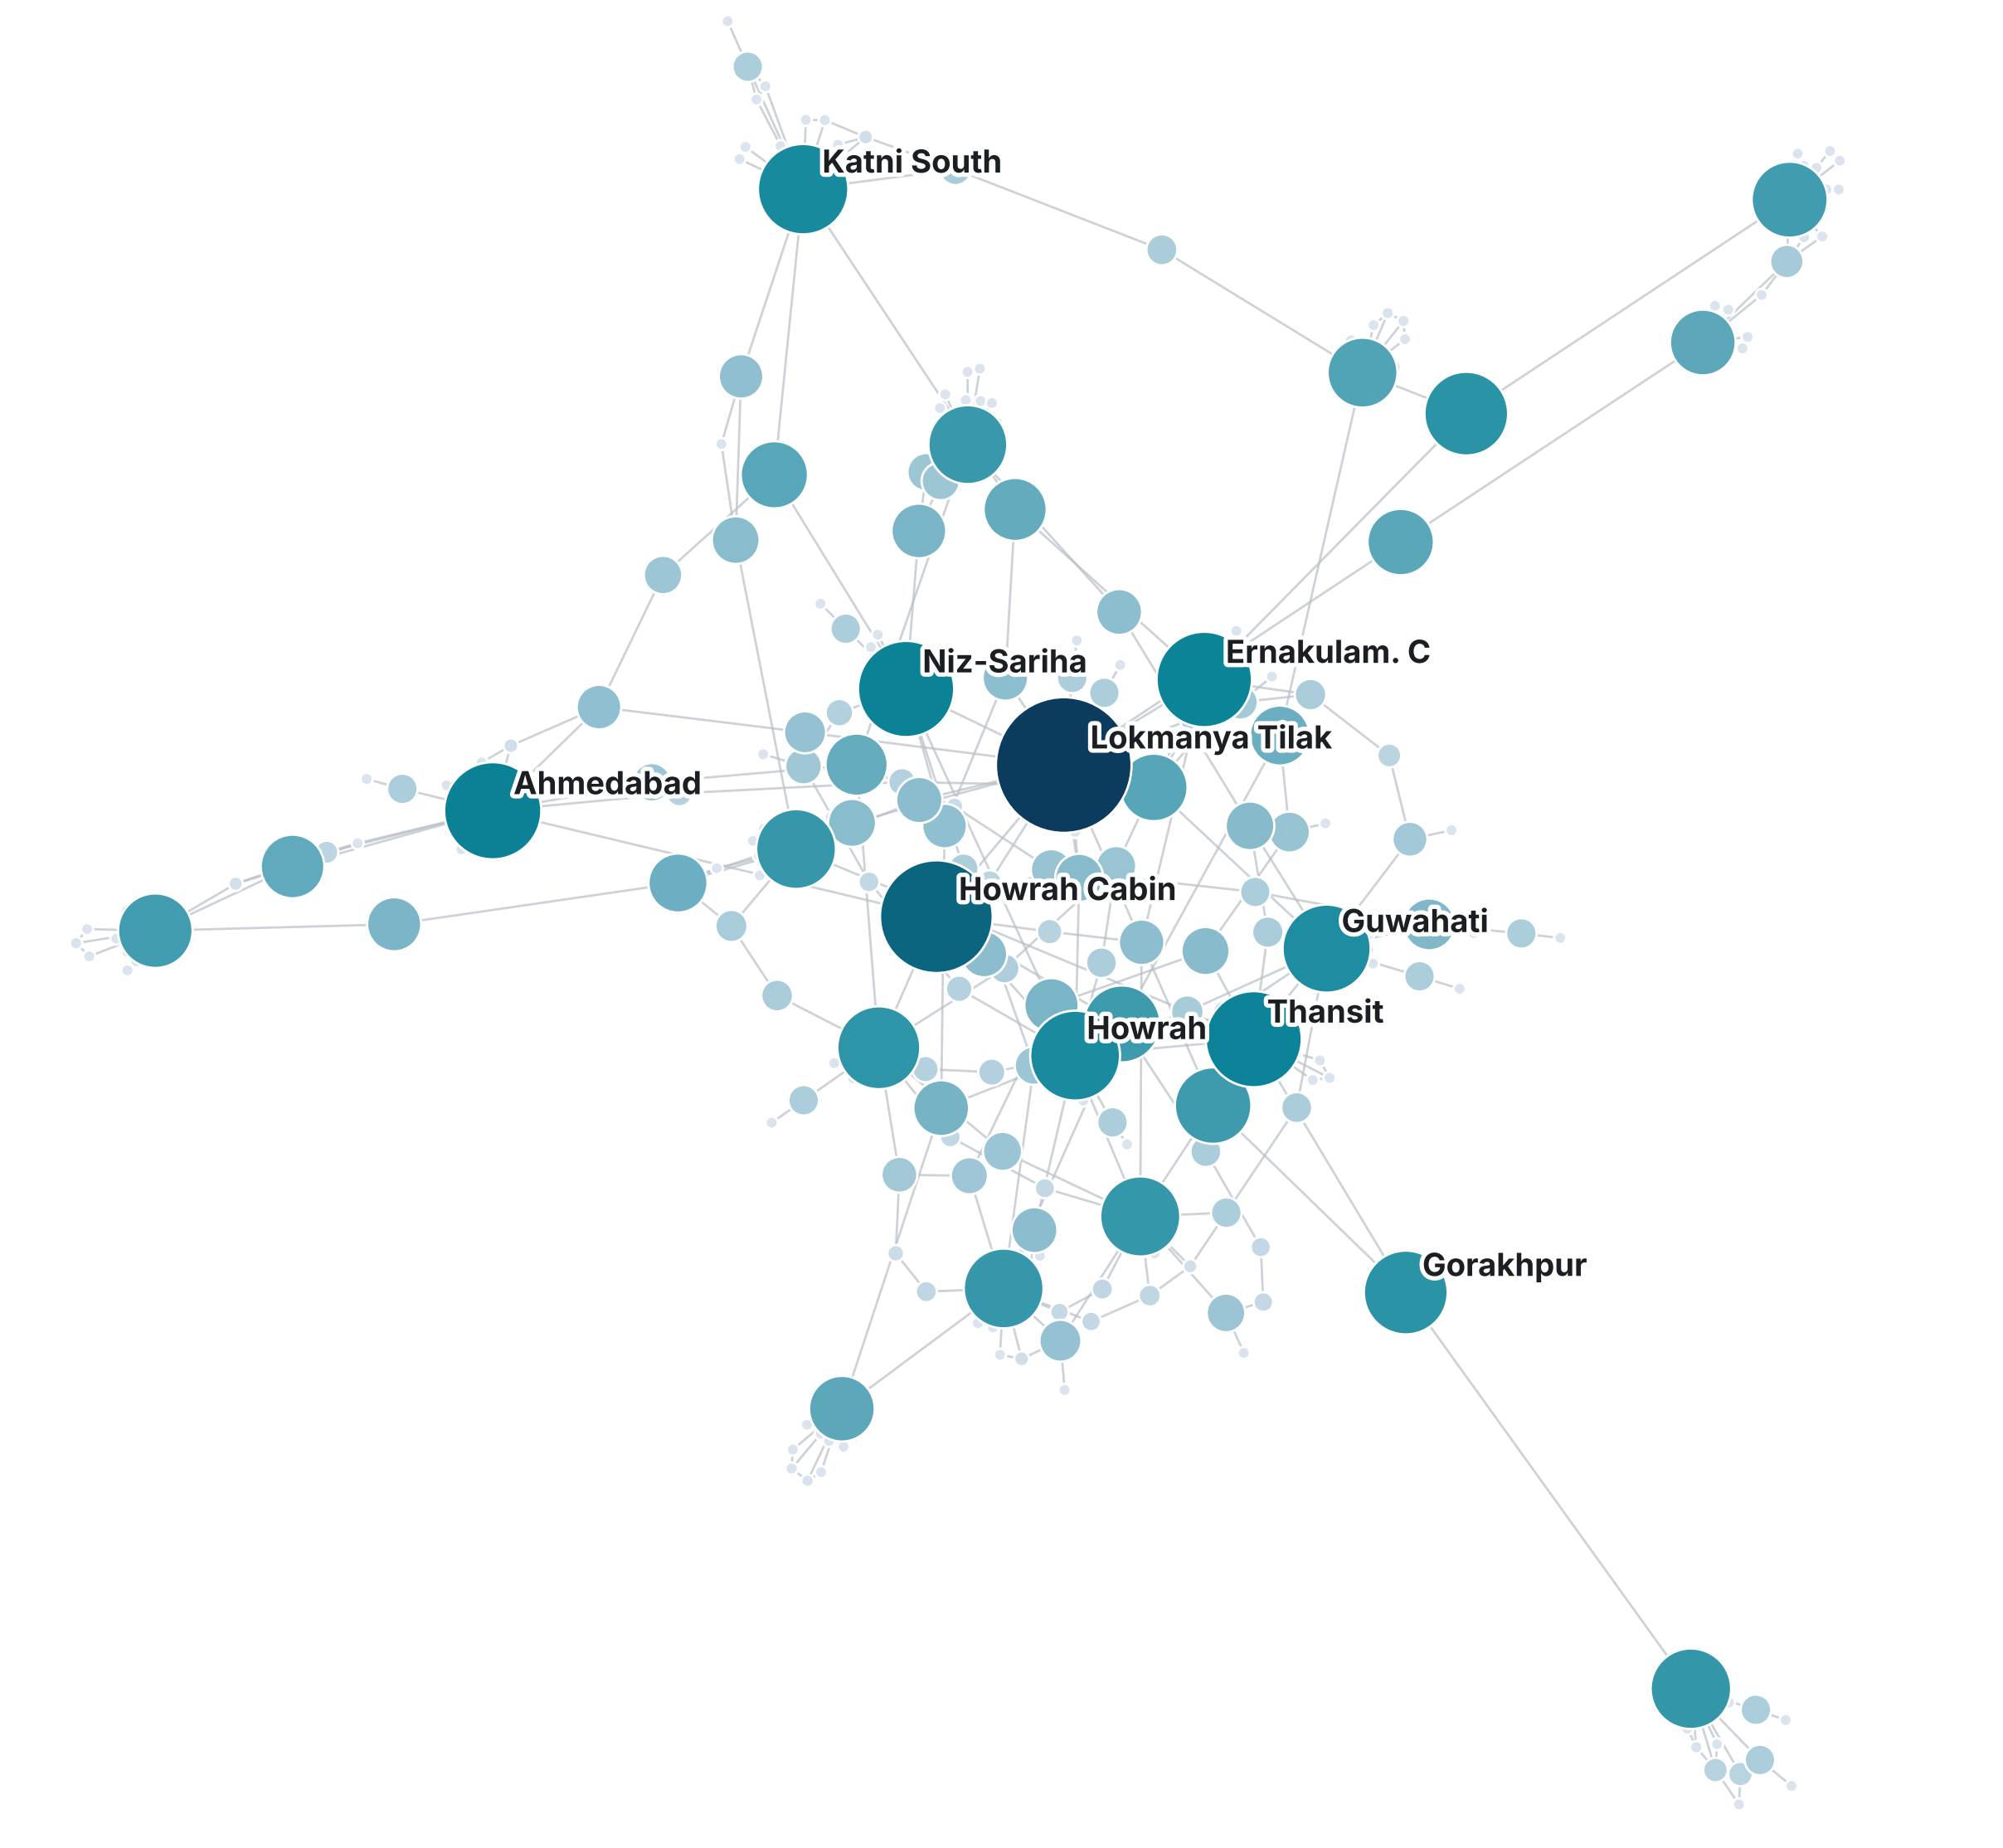
Same network, bridge view
Graph 2
What it shows
Bigger, darker dots = more shortest routes pass through the station.
Who stands out
Lokmanya Tilak and Howrah Jn. Cabin are far darker than the rest.
Not a hub, still a bridge
Gorakhpur is mid-sized but sits on the only long link to a far cluster.
Notes:
Same layout as the first graph, but now size and colour show betweenness instead of links. The first graph answered who is busy; this one answers who holds routes together. Lokmanya Tilak and Howrah Jn. Cabin stand out. Gorakhpur is not a big hub but still shows as a bridge because it sits on the long link to a far cluster. Many small light dots are stations no shortest route passes through.

Slide 6
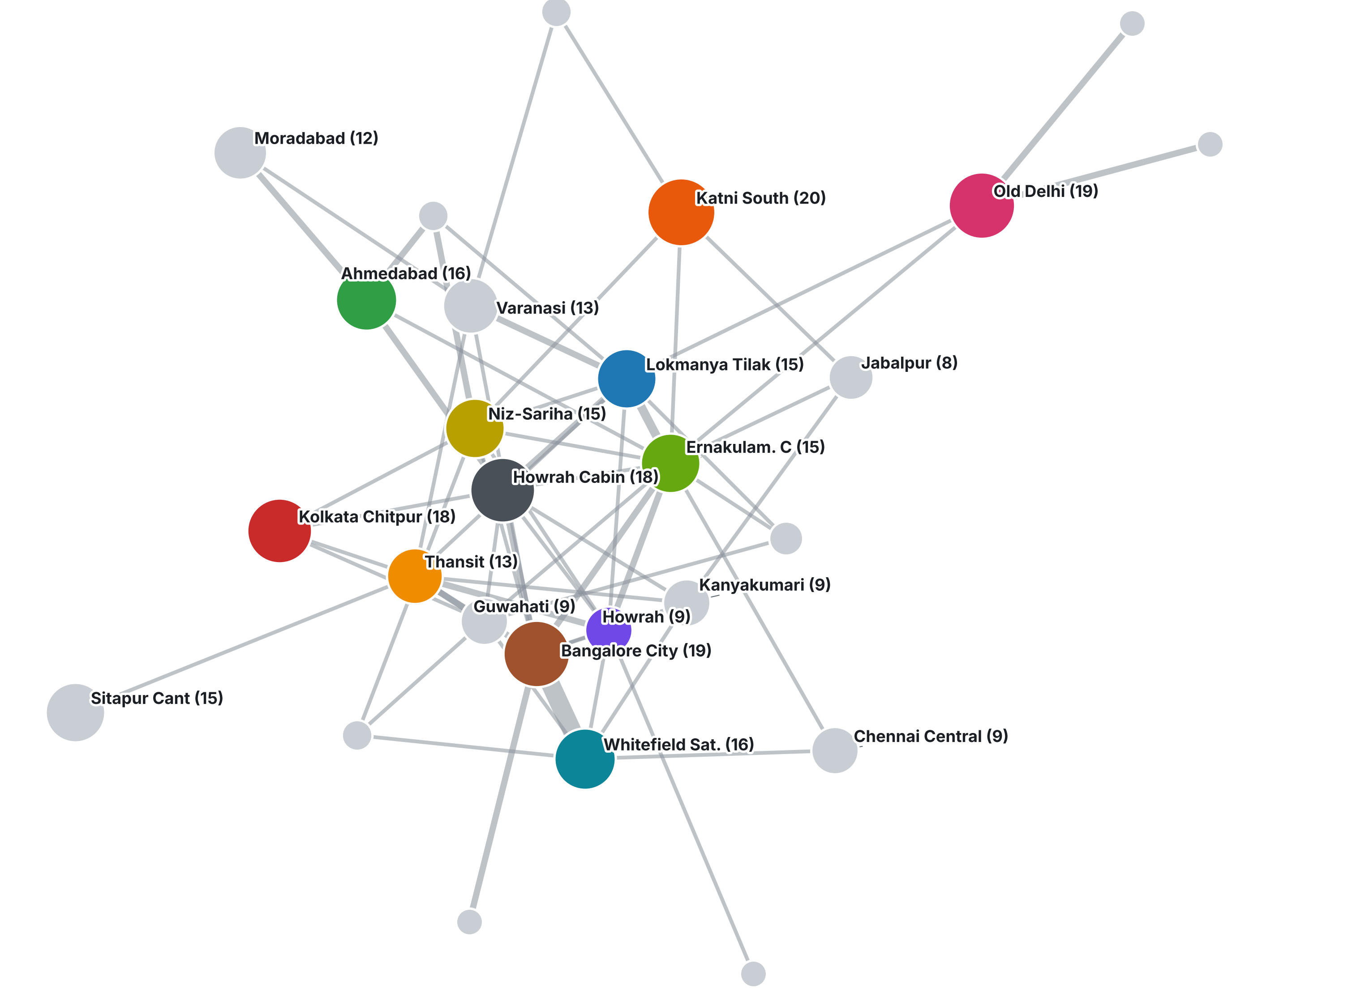
How the groups connect
Graph 3
27 groups
Each dot is a whole community; size = number of stations.
315 of 400 links
stay inside a group. Only 85 links cross between groups.
So, what
A few cross-group links hold the groups together; stations at their ends are the bridges.
Notes:
We collapsed each community into one dot to see the big picture. 315 of the 400 links stay inside a community, only 85 cross between communities. So the groups are tight, and just a few links tie them together. Those cross-group links, and the stations at their ends, are the bridges we measured.

Slide 7
Network metrics
Criterion 2
Degree: direct links
Betweenness: bridging role
Few stations have many links; 109 of 289 have just one. Hubs are rare.
Counts shortest paths through a station. Lokmanya Tilak leads both, but Howrah Jn. Cabin ranks 2nd here only.
0.926
Modularity: 27 communities, strongly clustered
5.20
Average path: any two stations, about 5 links apart
10
Diameter: longest shortest path
0.360
Clustering: neighbours often link to each other
Notes:
Two main metrics. Degree is the number of direct links: Lokmanya Tilak 24, Katni South 20, Ahmedabad 17. Betweenness counts how many shortest routes between other stations pass through a station: Lokmanya Tilak is far ahead at about 14,700. Notice Howrah Jn. Cabin is second on betweenness but not top five on degree, so the two metrics tell different stories. Supporting numbers: modularity 0.926 with 27 communities means the network is very clustered; average path length 5.2 and diameter 10 mean it is stretched out; clustering 0.36 is Gephi's average over stations with at least two links.

Slide 8
Visual encoding
Criterion 3
Channel | Encodes | Why it works | In our Gephi project
Node size | Degree (direct links) | Hubs stand out instantly | Configured: Appearance, size ranked by Degree
Node colour | Community (modularity class) | Colour groups = clusters | Configured: partition on Modularity Class
Edge thickness | Link weight (route count) | Busy links look heavier | Configured: Edge thickness reflects connection weight
Edge colour | Endpoint colour (mixed) | Links inside a community match it | Configured: Preview edge colour "mixed"
Together: size answers "who is big?", colour answers "who belongs together?", edges answer "how strong is the link?"
Notes:
Four visual channels, each with one job. Node size is degree, so hubs pop out. Node colour is community. Edge thickness should show weight and edge colour follows the endpoint colours. Be honest about status: in our saved Gephi project the Preview setting for edge weight is still off, so enable it under Preview > Edges before the final export. Everything else in the table is already set up.

Slide 9
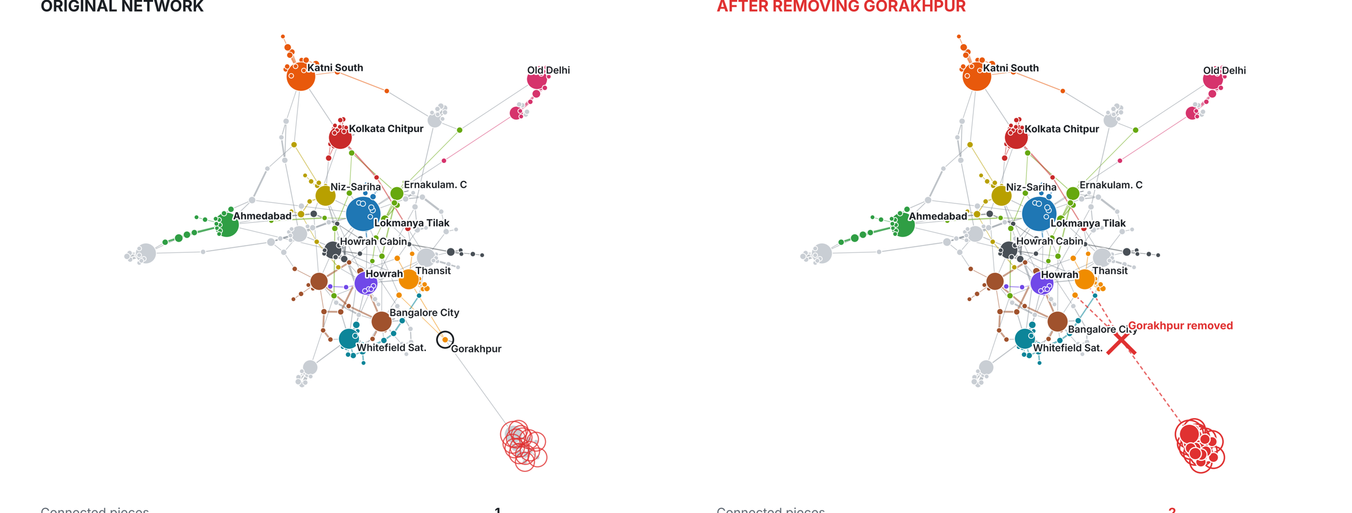
Insight: small station, big bridge
Criterion 4 | Graph 4
Gorakhpur Jn has only 3 direct links, yet removing it cuts 15 stations off the main network: the most of any of the 289 stations.
A degree table ranks it low. Only the graph shows it is the single thread holding a cluster. (Lokmanya Tilak: 8 pieces, path 5.20 to 5.71.)
Hypothetical network experiment on this dataset, not a prediction of real service disruption.
Notes:
Our one insight: being busy is not the same as being critical. Gorakhpur has only three direct links, so a degree table would not flag it. But in the graph it is the only route to a far cluster of stations around Sitapur. In a hypothetical removal test, taking it out cuts off 15 stations, more than any other single station. Removing Lokmanya Tilak, the top hub, cuts off 12 and lengthens routes: average path from 5.20 to 5.71 and diameter from 10 to 13. Stress that this is a network experiment on our dataset, not a prediction of real railway disruption.

Slide 10
Conclusions and limitations
What we learned
Limitations
A few hubs, many small stations: 109 of 289 have one link
27 tight communities (modularity 0.926)
Lokmanya Tilak leads in both degree and betweenness
Importance is not popularity: Gorakhpur bridges with 3 links
Partial network sample, not all of India
Some nodes are cabins or yards, or duplicate names (e.g. Howrah Jn. Cabin)
Metrics are structural; weights not used in betweenness
Removal test is hypothetical; Louvain varies slightly between runs
Notes:
Summarise: the network is a few hubs plus many small stations, organised into tight communities, and the most busy station is not the only structurally important one. Then be upfront about limits: partial sample, some nodes are operational records such as cabins, structural metrics only, and the removal test is hypothetical.

Slide 11
Thank you
Divyanshu Agwekar (2430010132) | Puru Bansal (2430010153)
Notes:
Invite questions. Likely ones: why ForceAtlas 2 (clusters without coordinates); why betweenness (finds bridges, not just busy stations); why remove Lokmanya Tilak (top by degree and betweenness).

